Slide 1
Asian Tourist In Paris
Proposing an AirBnB Apartment for Asian Tourists Visiting Paris

Slide 2
Introduction…………
In the city of Paris, there are thousands of tourists who have come to see the amazing city for its sheer beauty. These tourists are from different nationals and have cuisines which are specific to them. For example, Asians will prefer to go eat in restaurants that specialize in making Asian cuisines rather than eating in a restaurant that deals with different kinds of cuisines. To this end, the problem i intend to solve is deciding the best AirBnB apartment locations where Asian tourists can reside during a tourist visit to the city of Paris.

Slide 3
Data Source…………
To solve the stated problem, i will be using Foursquare's location data which will be accessed using their GET API.
The kind of data i will be accessing include:
Restaurants in Paris city
Asian restaurants and other interesting places around these restaurants
Also, i will be utilizing data from http://public.opendatasoft.com. This data will comprise of all AirBnB private room listings in the city of Paris,
their latitude and longitude, price per night, neighborhood of location and some other redundant data.

Slide 4
Methodology………..
The methodology to adopt for this problem can be briefly described in the following phases: 1. AirBnB Data collection from http://public.opendatasoft.com The AirBnB data will be accessed from OpenDataSoft and the data set will be limited to private rooms in AirBnB's listings in the city of Paris. The collected data set will be stored in a .csv format. 2. AirBnB Data preprocessing. The Airbnb data will be loaded into a pandas dataframe and data preprocessing techniques such as cleaning, trimming, shaping etc will be carried out on it to prepare it for processing. 3. EDA Exploratory data analysis will carried out on the data to better describe it and get some insight about the data 4. Utilization of Foursquare API search function The Foursquare API search function will then be used to find Asian restaurants within 500m of each AirBnB private room in Paris city. The JSON result will be cleaned and made ready for clustering 5. Clustering of Asian restaurants To properly group the asian restuarants with respect to the locations of AirBnB private rooms, the KNN machine learning technique will be used to cluster the restaurant into ten (10) different clusters.

Slide 5
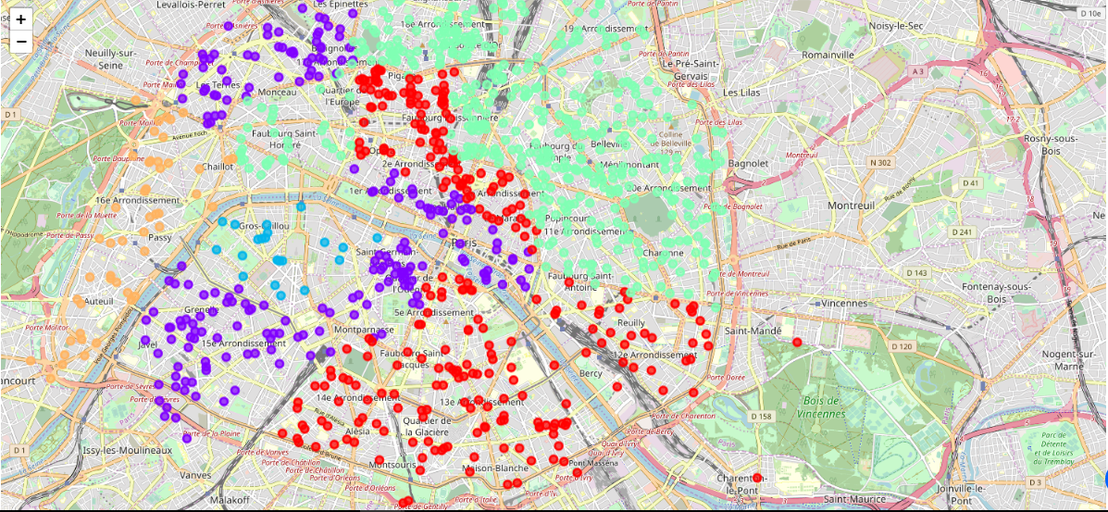
Result & Discussion……….

Slide 6
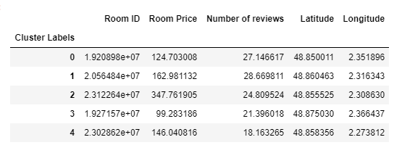
Results & Discussions……….

Slide 7
CLUSTER GROUP | PRICE GROUP
Cluster 1 | Very Cheap
Cluster 2 | Cheap
Cluster 3 | Moderate
Cluster 4 | Moderately Expensive
Cluster 5 | Expensive

Slide 8
Conclusion & Recommendations
From the results, it is seen that the KNN machine learning algorithm is a good tool for clustering Asian restaurants which are in proximity to AirBnB private room listings in the city of Paris. As a recommendation, to make the outcome even much better, one can consider the review of each of these restaurant to help the Asian tourist determine the locations with the most positive reviews. The price of the rooms can be factored into the KNN model. Also, the distance of each restaurant from the AirBnB private apartment can be computed to further help improve the outcome of the model.

